Slide 1

Chapter 3

Slide 2
Chapter 3 Outline
User Stories and Use Cases
Use Cases and the User Goal Technique
Use Cases and Event Decomposition
Use Cases in the Ridgeline Mountain Outfitters Case

Slide 3
User Stories
A User Story is a one-sentence description of a work-related task done by a user to achieve some goal or result
Acceptance Criteria identify the features that must be present at the completion of the task
The template for a user story description is:
“As a <role> I want to <goal> so that <benefit>
©2016. Cengage Learning. All rights reserved.

Slide 4
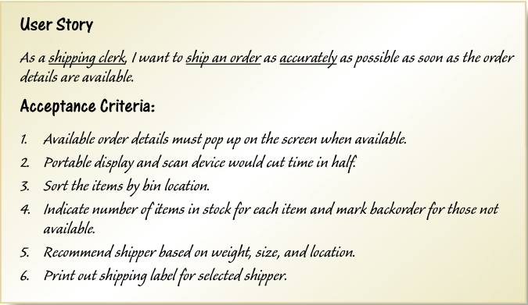
Sample User Story
©2016. Cengage Learning. All rights reserved.

Slide 5
Use Cases
Use case— an activity that the system performs, usually in response to a request by a user
Use cases define functional requirements
Analysts decompose the system into a set of use cases (functional decomposition)
Two techniques for Identifying use cases
User goal technique
Event decomposition technique
Name each use case using Verb-Noun
©2016. Cengage Learning. All rights reserved.

Slide 6
User Goal Technique
This technique is the most common in industry
Simple and effective
Identify all of the potential categories of users of the system
Interview and ask them to describe the tasks the computer can help them with
Probe further to refine the tasks into specific user goals, “I need to Ship items, Track a shipment, Create a return”
©2016. Cengage Learning. All rights reserved.

Slide 7
User Goal Technique Some RMO CSMS Users and Goals
©2016. Cengage Learning. All rights reserved.

Slide 8
User Goal Technique: Specific Steps
Identify all the potential users for the new system
Classify the potential users in terms of their functional role (e.g., shipping, marketing, sales)
Further classify potential users by organizational level (e.g., operational, management, executive)
For each type of user, interview them to find a list of specific goals they will have when using the new system (current goals and innovative functions to add value)
©2016. Cengage Learning. All rights reserved.

Slide 9
User Goal Technique: Specific Steps (continued)
Create a list of preliminary use cases organized by type of user
Look for duplicates with similar use case names and resolve inconsistencies
Identify where different types of users need the same use cases
Review the completed list with each type of user and then with interested stakeholders
©2016. Cengage Learning. All rights reserved.

Slide 10
Event Decomposition Technique
More Comprehensive and Complete Technique
Identify the events that occur to which the system must respond.
For each event, name a use case (verb-noun) that describes what the system does when the event occurs
Event– something that occurs at a specific time and place, can be described, and should be remembered by the system
©2016. Cengage Learning. All rights reserved.

Slide 11
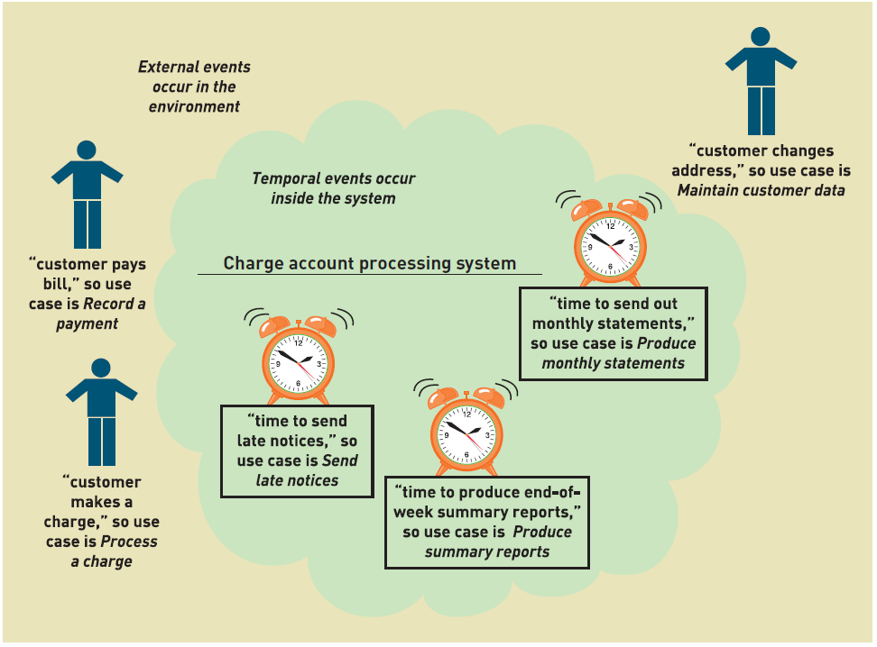
Events and Use Cases
©2016. Cengage Learning. All rights reserved.

Slide 12
Types of Events
External Event
an event that occurs outside the system, usually initiated by an external agent or actor
Temporal Event
an event that occurs as a result of reaching a point in time
State Event
an event that occurs when something happens inside the system that triggers some process
reorder point is reached for inventory item
©2016. Cengage Learning. All rights reserved.

Slide 13
External Event Checklist
External agent or actor wants something resulting in a transaction
Customer buys a product
External agent or actor wants some information
Customer wants to know product details
External data changed and needs to be updated
Customer has new address and phone
Management wants some information
Sales manager wants update on production plans
©2016. Cengage Learning. All rights reserved.

Slide 14
Temporal Event Checklist
Internal outputs needed at points in time
Management reports (summary or exception)
Operational reports (detailed transactions)
Internal statements and documents (including payroll)
External outputs needed at points of time
Statements, status reports, bills, reminders
©2016. Cengage Learning. All rights reserved.

Slide 15
Finding the actual event that affects the system
©2016. Cengage Learning. All rights reserved.

Slide 16
Tracing a sequence of transactions resulting in many events
©2016. Cengage Learning. All rights reserved.

Slide 17
Event Decomposition Technique: Specific Steps
Consider the external events in the system environment that require a response from the system by using the checklist shown in Slide 11
For each external event, identify and name the use case that the system requires
Consider the temporal events that require a response from the system by using the checklist shown in Slide 13
For each temporal event, identify and name the use case that the system requires and then establish the point of time that will trigger the use case
©2016. Cengage Learning. All rights reserved.

Slide 18
Event Decomposition Technique: Specific Steps (continued)
Consider the state events that the system might respond to, particularly if it is a real-time system in which devices or internal state changes trigger use cases.
For each state event, identify and name the use case that the system requires and then define the state change.
When events and use cases are defined, check to see if they are required by using the perfect technology assumption. Do not include events that involve such system controls as login, logout, change password, and backup or restore the database, as these are put in later.
©2016. Cengage Learning. All rights reserved.

Slide 19
Event Decomposition Technique: Benefits
Events are broader than user goal: Capture temporal and state events
Help decompose at the right level of analysis: an elementary business process (EBP)
EBP is a fundamental business process performed by one person, in one place, in response to a business event
Uses perfect technology assumption to make sure functions that support the users work are identified and not additional functions for security and system controls
©2016. Cengage Learning. All rights reserved.

Slide 20
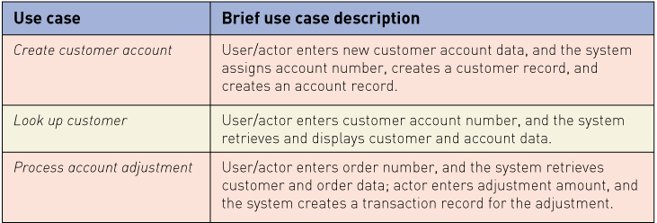
Use Cases and Brief Use Case Descriptions
Brief use case description is often a one sentence description showing the main steps in a use case
©2016. Cengage Learning. All rights reserved.

Slide 21
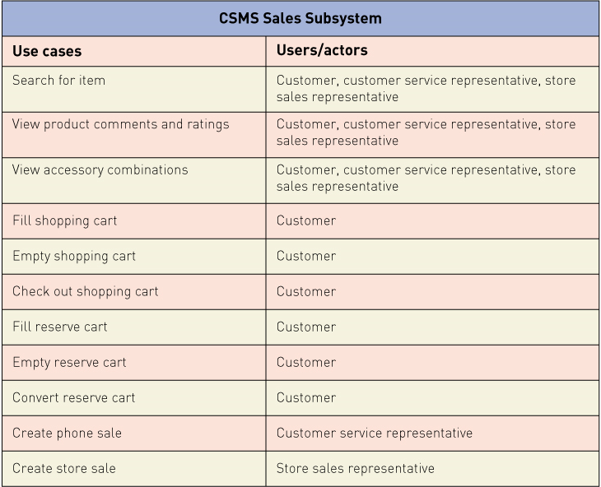
RMO CSMS Project Use Cases
©2016. Cengage Learning. All rights reserved.

Slide 22
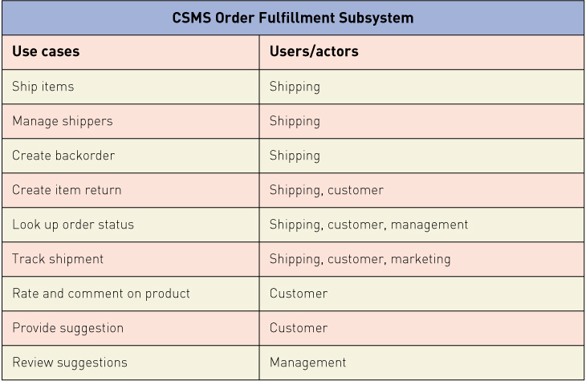
RMO CSMS Project Use Cases
©2016. Cengage Learning. All rights reserved.

Slide 23
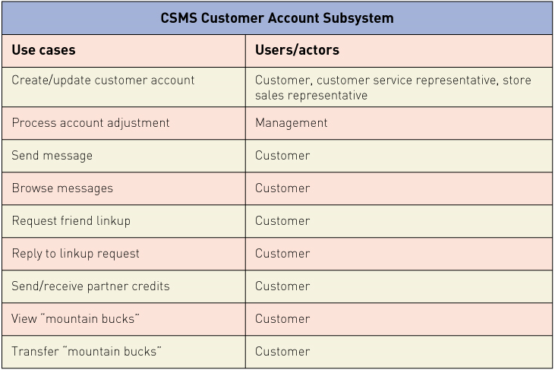
RMO CSMS Project Use Cases
©2016. Cengage Learning. All rights reserved.

Slide 24
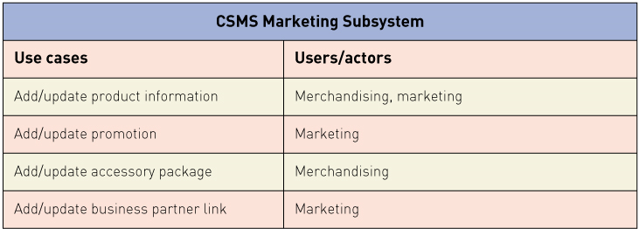
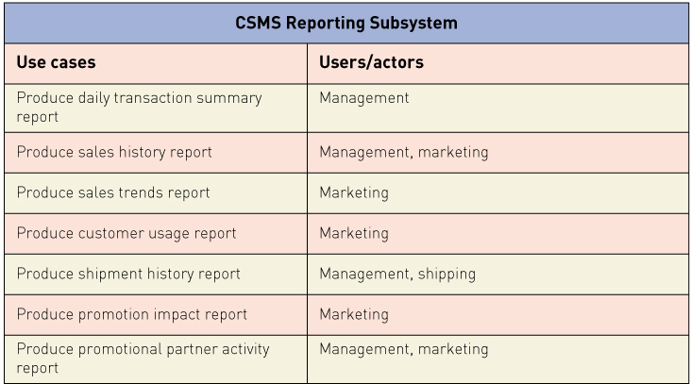
RMO CSMS Project Use Cases
©2016. Cengage Learning. All rights reserved.

Slide 25
Use Case Diagrams
Use case diagram— a UML model used to graphically show uses cases and their relationships to actors
Recall UML is Unified Modeling Language, the standard for diagrams and terminology for developing information systems
Actor is the UML name for a end user
Automation boundary— the boundary between the computerized portion of the application and the users who operate the application
©2016. Cengage Learning. All rights reserved.

Slide 26
Use Case Diagrams Symbols
©2016. Cengage Learning. All rights reserved.

Slide 27
Use Case Diagrams Draw for each subsystem
©2016. Cengage Learning. All rights reserved.

Slide 28
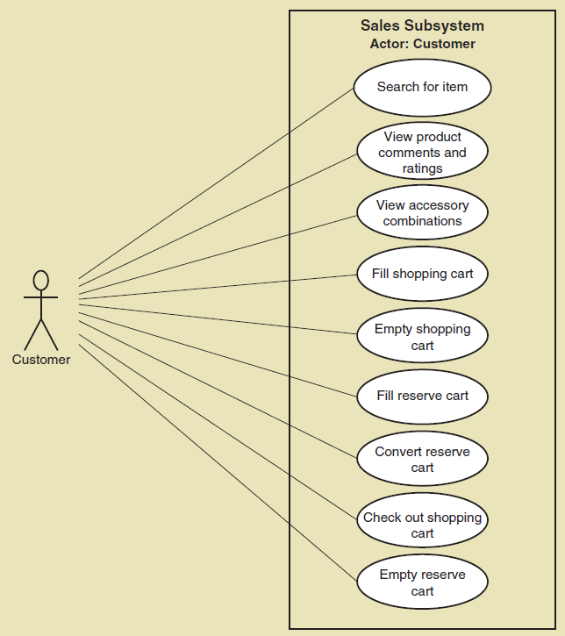
Use Case Diagrams Draw for a single actor, such as customer
©2016. Cengage Learning. All rights reserved.

Slide 29
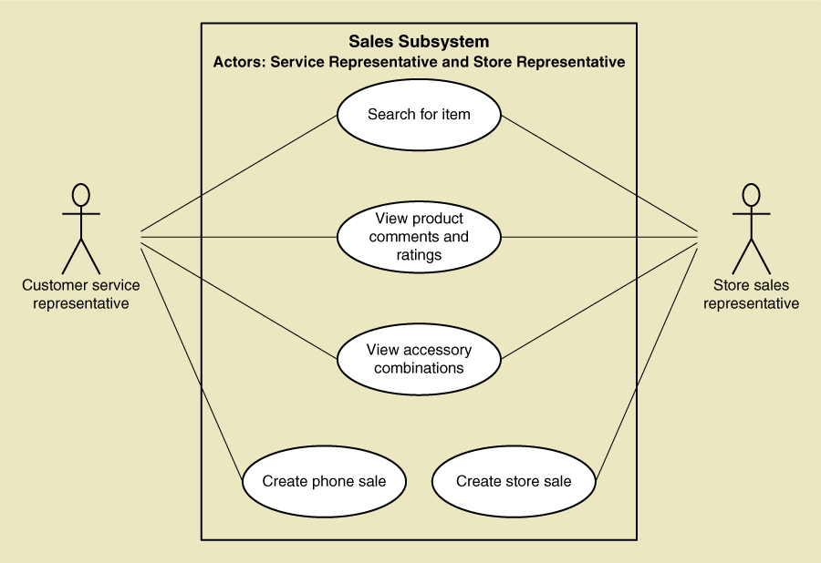
Use Case Diagrams Draw for internal RMO actors
©2016. Cengage Learning. All rights reserved.

Slide 30
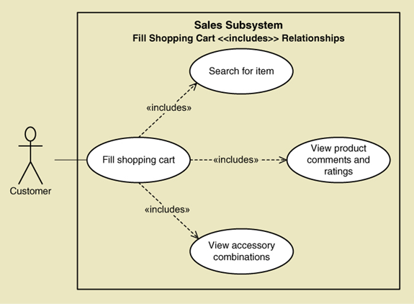
Use Case Diagrams— The <<Includes>> relationship
A relationship between use cases where one use case is stereotypically included within the other use case— like a called subroutine. Arrow points to subroutine
©2016. Cengage Learning. All rights reserved.

Slide 31
Use Case Diagrams: Steps
Identify all the stakeholders and users who would benefit by seeing a use case diagram
Determine what each stakeholder or user needs to review in a use case diagram: each subsystem, for each type of user, for use cases that are of interest
For each potential communication need, select the use cases and actors to show and draw the use case diagram. There are many software packages that can be used to draw use case diagrams
Carefully name each use case diagram and then note how and when the diagram should be used to review use cases with stakeholders and users
©2016. Cengage Learning. All rights reserved.

Slide 32
Use Case Diagrams Draw for internal RMO actors
©2016. Cengage Learning. All rights reserved.

Slide 33
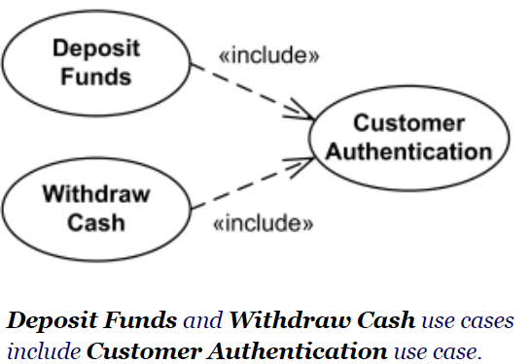
Use Case Diagrams— The <<Include>> relationship
Include relationship between use cases is shown by a dashed arrow from the including (base) use case to the included (common part) use case.
It is a relationship where one use case is stereotypically included within the other use case— like a called subroutine.
©2016. Cengage Learning. All rights reserved.

Slide 34
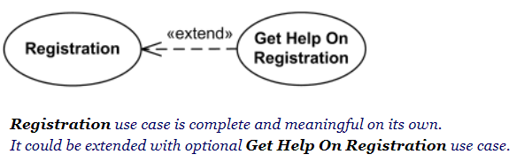
Use Case Diagrams— The <<extend>> relationship
Extend is a directed relationship that specifies how and when the behavior defined in usually supplementary (optional)
Extended use case is meaningful on its own, it is independent of the extending use case. Extending use case typically defines optional behavior that is not necessarily meaningful by itself. The extend relationship is owned by the extending use case. The same extending use case can extend more than one use case, and extending use case may itself be extended.

Slide 35
Example- develop a use-case diagram
Students will use the library information system to search for book titles and to see whether a book is available or not. A student can also access the system to reserve a book if all copies are checked out. In all cases, a student must first login to the system before doing these tasks.
Clerks also use the system, when students bring books to the circulation desk, clerks check out the books on a loan. Clerks also check books in when books are dropped in the return slot. An optional message may be sent to the student upon his request.

Slide 36
Example
Develop a mobile application to allow the user to make a call and send a text message. In the case of sending a message, the user presses the “messages” button; a suitable interface is presented to the user, which allows him/her to enter the text and the receiver contact number. Once finished, the user must press the “done button” to send the message. The user can also set Time and Date using the mobile application. Finally, the user must pay fees to the service provider; the user makes payment by filling in all the required details of his/her valid credit card. The bank system then validates the payment and credits his account.

Slide 37
Example
Assume an online Banking System where its main purpose is to keep track of all customers transactions. In this system, a customer must first open or create an account to make transactions. Once the account is opened successfully, the customer can deposit, withdraw, or transfer money. In all cases, the system checks the customer balance, makes the transaction, and then updates the customer balance. Customers can also update their information through this system. To do this, the customer provides the new information, which will be validated, and then updated the customer information.

Slide 38
Example
Assume the BIO system where its main purpose is to keep track of all student’s information. There are two types of users: a student who must login to the system to view his marks, download the courses material, and update his information.
The second type of users is Instructors, who must login to the system to upload the marks either by directly entering the marks or uploading an excel file with the marks. In the case of successful uploading, a confirmation message is sent to the instructor.

Slide 39
Example5
A furniture company has recently decided to release mobile app in order to automate ordering process.
The company sells two types of furniture that are indoor and outdoor. Each of them should be in different order. In order to start shopping, each customer must create an account using his/her email and password. The customer then login to start the shopping process, where an indoor or outdoor furniture can be ordered, and once customer finished from ordering, the customer does payment for the company.

